Slide 1


In the name of God
Impacts of Economic Sanctions on Population Health and Health System: A Study at National and Sub-national Levels (2000–2020 in Iran)
Authors:
Efat Mohamadi, Alexander Kraemer, Reza Majdzadeh, Morteza Mohamadzade, Marita Mohammadshahi, Mohammad Mehdi Kiani, Fatemeh Ebrahimi, Hakimeh Mostafavi, Alireza Olyaeemanesh* and Amirhossein Takian*
Health Equity Research Center
Social Determinates Health Research Network of Iran

Slide 2
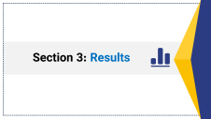
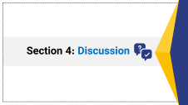
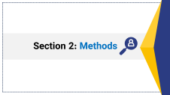
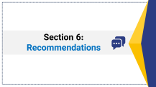
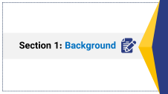
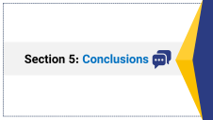
Over view of contents
6
5
4
3
2
1

Slide 3
Section 1: Background

Slide 4
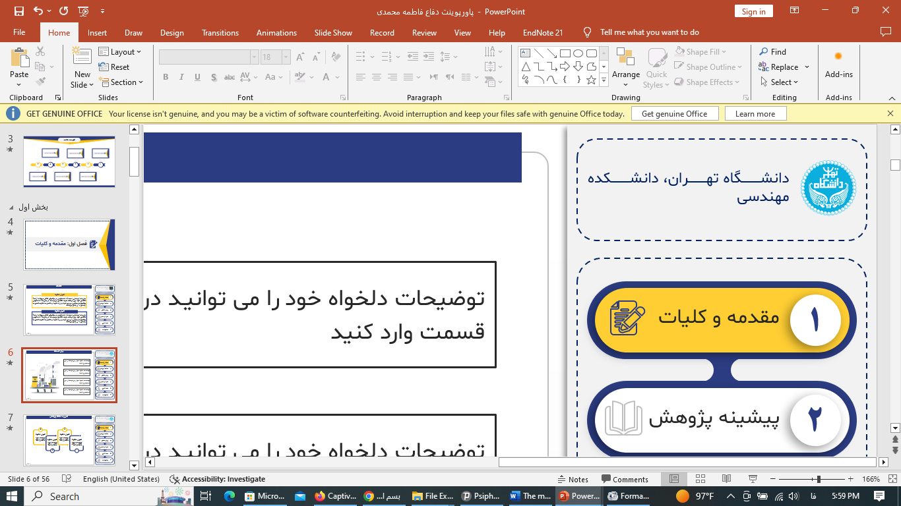
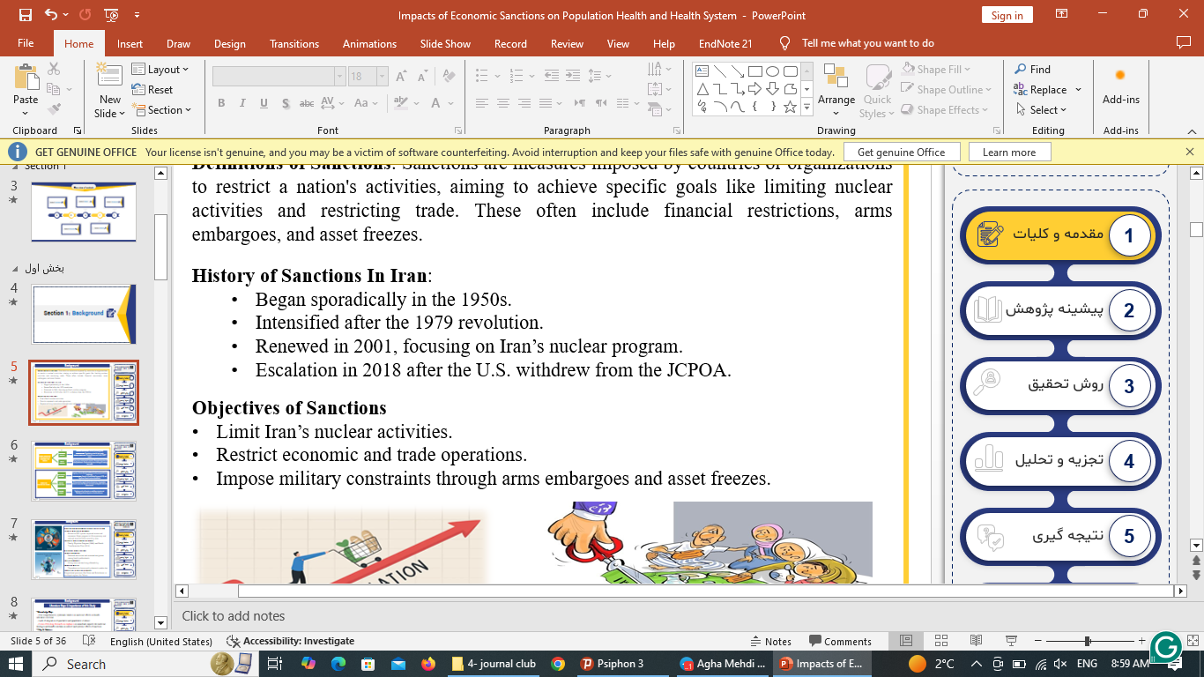
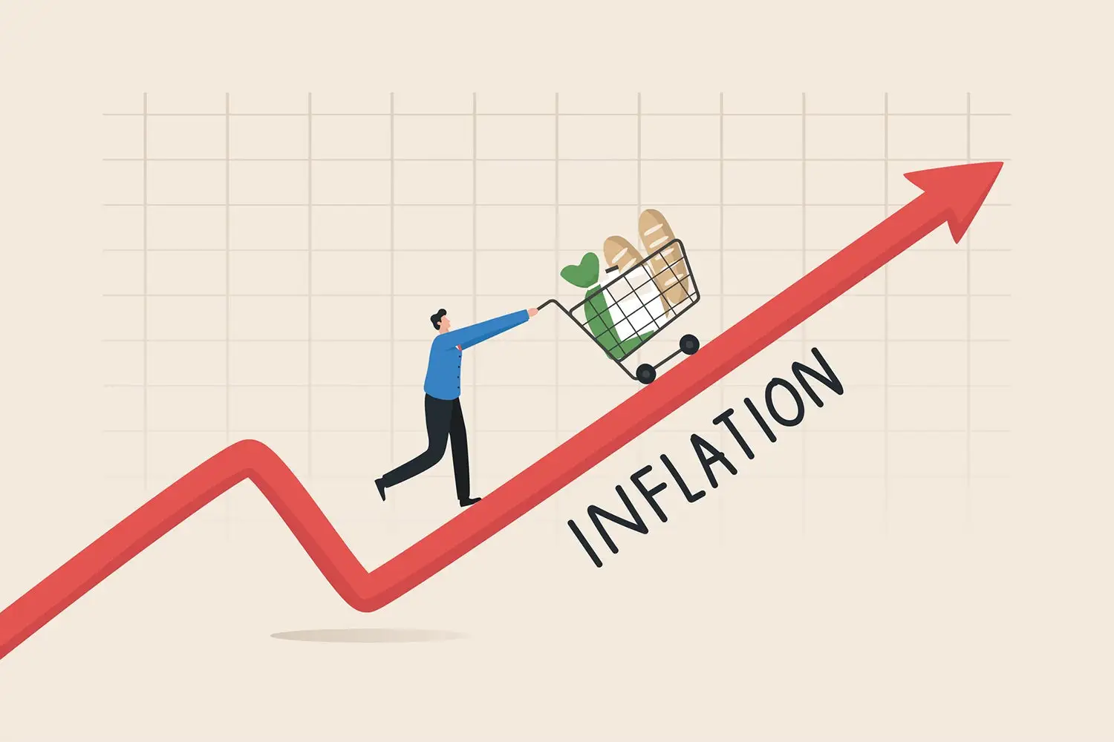
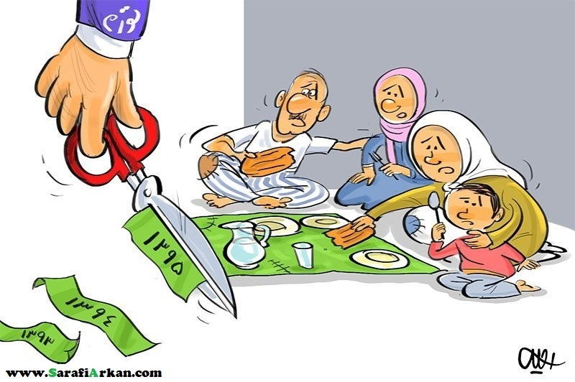
Background
Impacts of Economic Sanctions on Population Health and Health System
Definitions of Sanctions: Sanctions are measures imposed by countries or organizations to restrict a nation's activities, aiming to achieve specific goals like limiting nuclear activities and restricting trade. These often include financial restrictions, arms embargoes, and asset freezes.
History of Sanctions In Iran:
  Began sporadically in the 1950s.
  Intensified after the 1979 revolution.
  Renewed in 2001, focusing on Iran’s nuclear program.
  Escalation in 2018 after the U.S. withdrew from the JCPOA.
Objectives of Sanctions
Limit Iran’s nuclear activities.
Restrict economic and trade operations.
Impose military constraints through arms embargoes and asset freezes.
Background
1
Methods
2
Results
3
Discussion
4
Conclusion
5
6
Recommendations

Slide 5
Background
Impacts of Economic Sanctions on Population Health and Health System
Direct Impacts of Sanctions on the Economy and Society
Economic Impacts
Currency Devaluation: Reduced purchasing power.
Hyperinflation: Skyrocketing prices for basic goods.
Financial Constraints: Blocked accounts and limited SWIFT access.
Rising poverty and economic inequality. Increased emigration of skilled professionals. Families facing severe challenges in meeting basic needs.
Social Impacts
1
1
Background
1
2
2
Methods
2
3
3
Results
3
Effects on Healthcare System
Healthcare Services
Medicine and Equipment Shortages: Limited access to specific drugs (e.g., for rare diseases) and Lower-quality equipment due to substitution.
Increased Costs: Growth in Out-of-Pocket Payments (OOP) and Significant financial strain on households.
Rising mortality rates for chronic diseases (e.g., hypertension, diabetes, cancer) and Reduced vaccination coverage and infectious disease control.
Health Indicators
Indirect Effects
Declining quality of care due to workforce migration and Widening provincial disparities in healthcare access.
4
4
Discussion
4
5
5
Conclusion
5
6
6
Recommendations

Slide 6
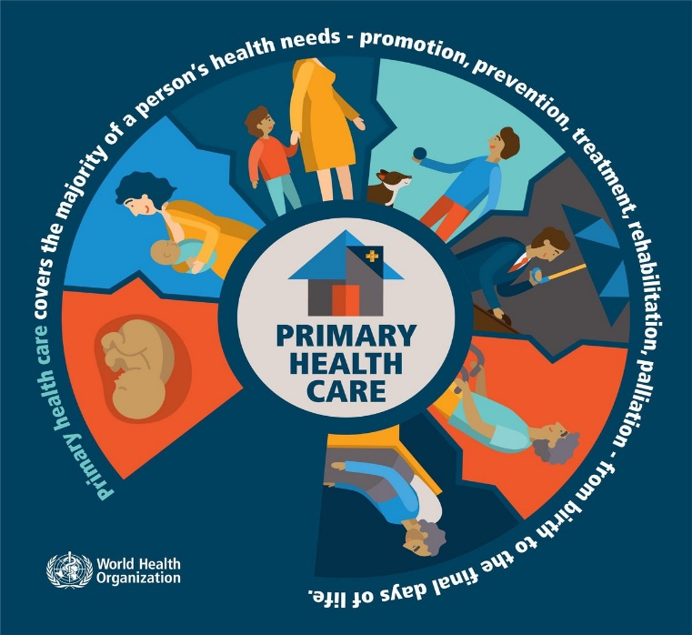
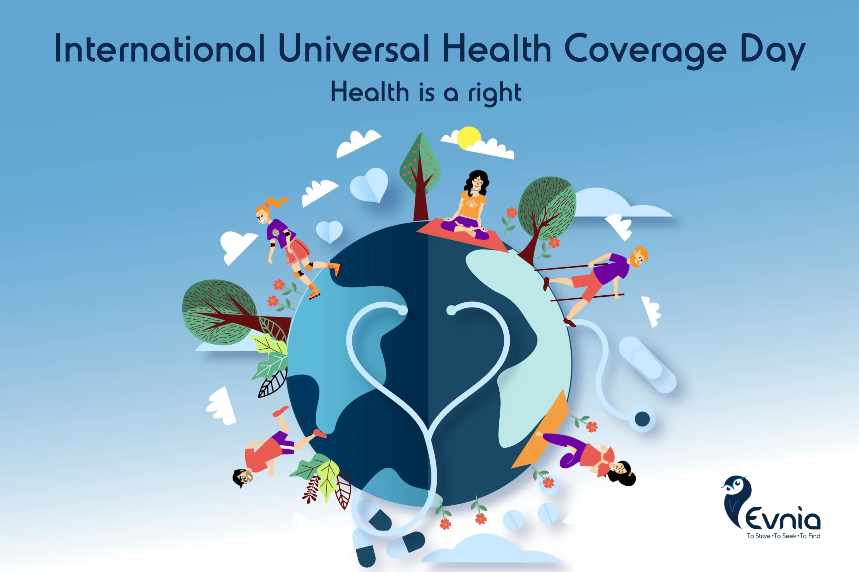
Background
بررسی ساختار بازار واردات تجهیزات و ملزومات مصرفی پزشکی در زنجیره تامین نظام سلامت ایران در طول سال های 1397-1401
Pre-Sanction Achievements of Healthcare System
Primary Healthcare Network:
  Extensive PHC system improved access and outcomes. Major progress in life expectancy and reduced maternal/infant mortality rates.
Universal Health Coverage (UHC):
  Family Physician Program (2004) and Health Transformation Plan (2014).
1
1
1
Background
1
2
2
2
Methods
2
3
3
3
Results
3
4
4
4
Discussion
4
5
5
5
Conclusion
5
6
6
Recommendations

Slide 7
Background
Impacts of Economic Sanctions on Population Health and Health System
Literature Gaps & Importance of this Study
• Knowledge Gap:
- Few comprehensive, systematic studies on sanctions' effects on health indicators over time
- Lack of integration of qualitative and quantitative evidence
- Focus of Existing Research on emphasis on immediate impacts like medicine shortages and Insufficient data on indirect and systemic effects of sanctions
- Limited global understanding of sanctions’ long-term impacts on health systems
1
1
1
Background
1
2
2
2
Methods
2
3
3
3
Results
3
4
4
4
Discussion
4
Challenge Identified was:
Limited studies on healthcare, long-term health outcomes, and regional disparities
Unaddressed Question was:
- How do sanctions impact on health and exacerbate existing inequities?
5
5
5
Conclusion
5
6
6
Recommendations

Slide 8


Background
Impacts of Economic Sanctions on Population Health and Health System
Objectives of the Study
Quantify the impacts of sanctions on health resources and outcomes
Analyze regional disparities across provinces
Identify perspectives of patients and policymakers
Provide evidence-based recommendations for policy interventions
1
1
1
Background
1
2
2
2
Methods
2
3
3
3
Results
3
4
4
4
Discussion
4
5
5
5
Conclusion
5
6
6
Recommendations

Slide 9
Section 2: Methods

Slide 10
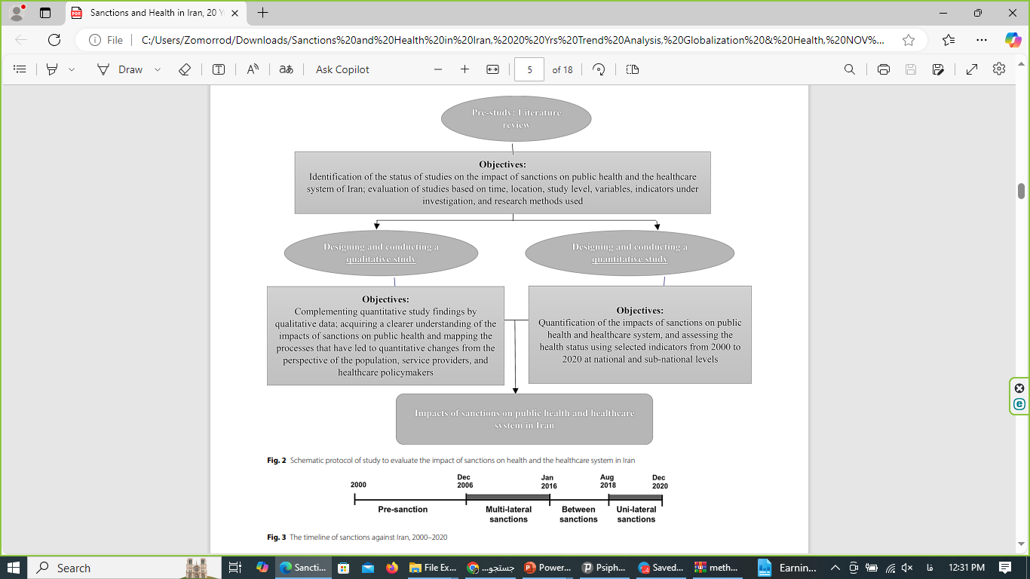
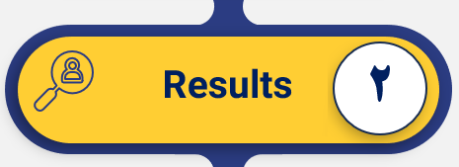
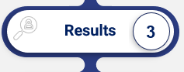
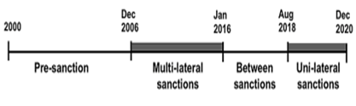
Overview of Mixed-Methods Study
Impacts of Economic Sanctions on Population Health and Health System
This mixed-methods (quantitative/qualitative) study was conducted between 2019 and 2022.
The quantitative component aimed to assess the effects of sanctions on 28 selected healthcare indicators, including macroeconomic factors, healthcare resources, and health outcomes, at both national and sub-national levels in Iran, covering the period from 2000 to 2020.
Join Point Regression (JPR) and General Additive Mixed Effect Models (GAMM) were used to analyze trends and relationships between variables.
The qualitative component involved semi-structured, in-depth, face-to-face interviews with patients and policymakers, exploring their perspectives on the effects of sanctions.
These interviews were analyzed using content analysis, which identified recurring themes and subthemes.
1
1
1
Background
1
2
2
2
Methods
2
Methods
2
3
3
Results
3
4
4
4
Discussion
4
5
5
5
Conclusion
5
6
6
Recommendations

Slide 11
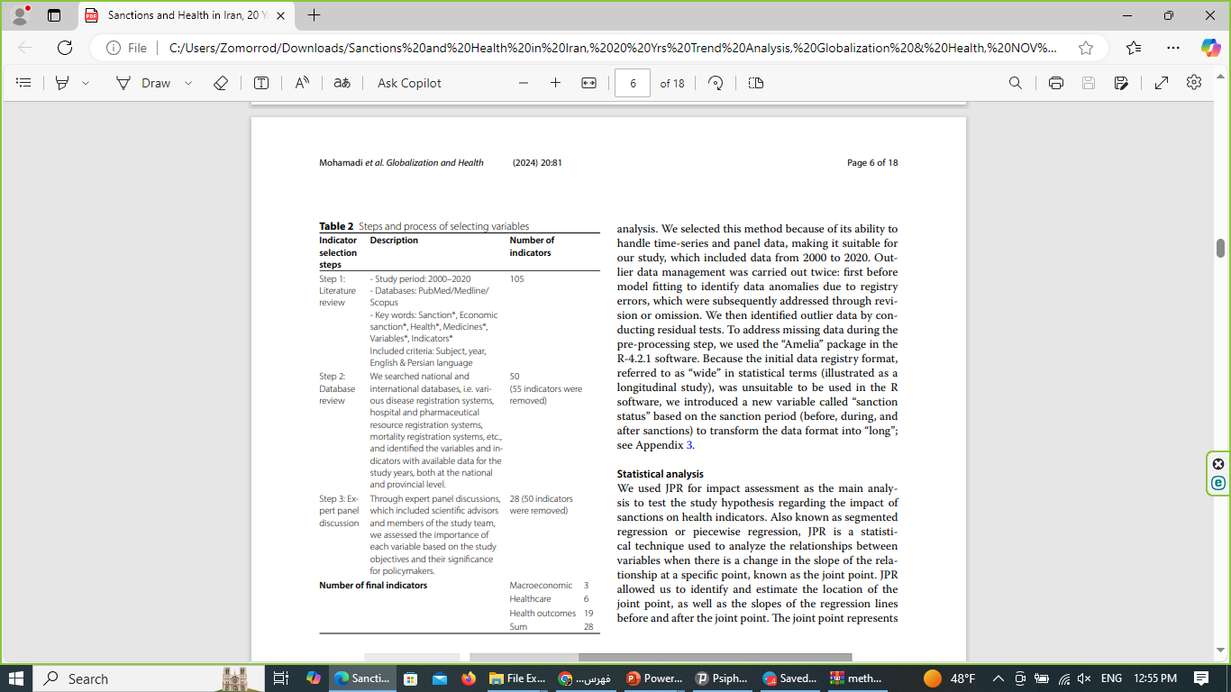
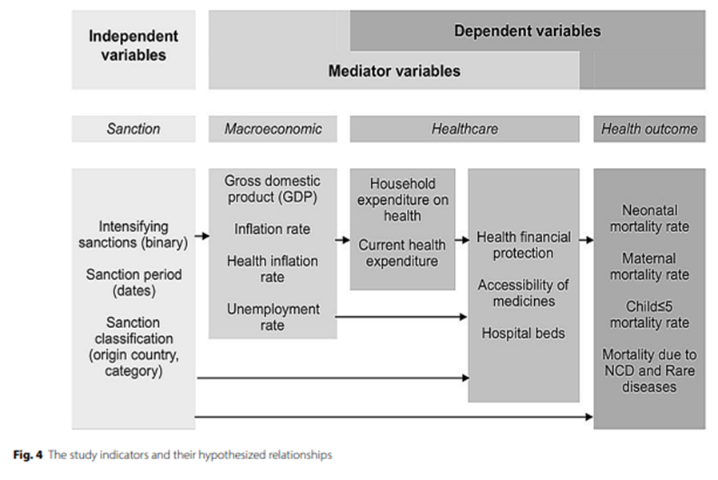
Quantitative Method & Study Variables
Impacts of Economic Sanctions on Population Health and Health System
Step | Description | Tools and Techniques
1. Identifying Variables and Indicators | - Literature review to select indicators and variables. - Reviewing national and international databases. - Prioritizing variables through expert consultation. | - Literature review (PubMed, Scopus). - Expert panel discussions. - Databases like WHO, World Bank.
1
1
1
Background
1
2
2
2
Methods
2
Methods
2
3
3
Results
3
4
4
4
Discussion
4
5
5
5
Conclusion
5
6
6
Recommendations

Slide 12

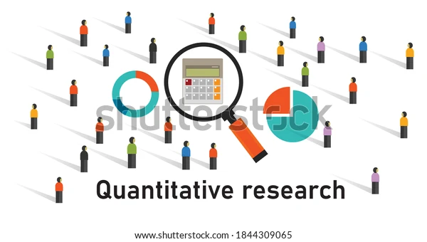
Quantitative Method
Impacts of Economic Sanctions on Population Health and Health System
Step | Description | Tools and Techniques
2. Data Collection | - Collecting quantitative data from 2000 to 2020. - Organizing data into Excel sheets. | - Sources: WHO, Statistical Center of Iran, disease registries.
3. Data Cleaning and Management | - Identifying and imputing missing data using statistical methods. - Correcting or removing inconsistent data. | - "Amelia" package in R for data imputation.
4. Data Analysis | - Applying advanced statistical models to analyze relationships. - Identifying trend change points in indicators. | - Join Point Regression (JPR). - General Additive Mixed Models (GAMM).
5. Visualization of Results | - Producing graphs to display indicator trends. - Using heatmaps to show provincial inequalities. | - "ggplot2" and "mcp" packages in R. - Advanced charting tools.
1
1
1
1
Background
1
Background
2
2
2
2
Methods
2
Methods
Methods
3
2
3
3
Results
3
Results
4
4
4
4
Discussion
4
Discussion
5
5
5
5
Conclusion
5
Conclusion
6
6
Recommendations
Recommendations

Slide 13
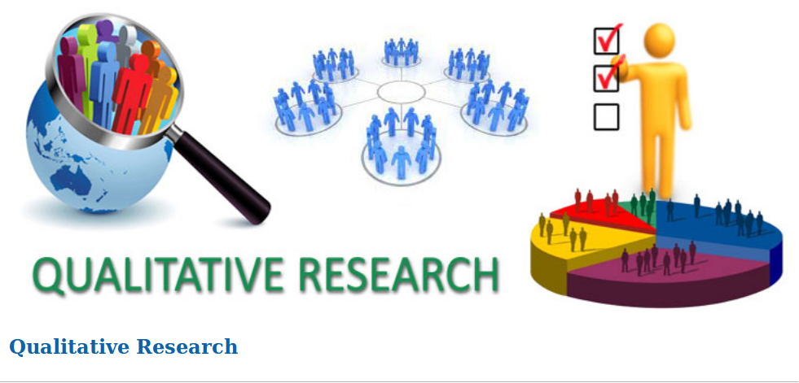
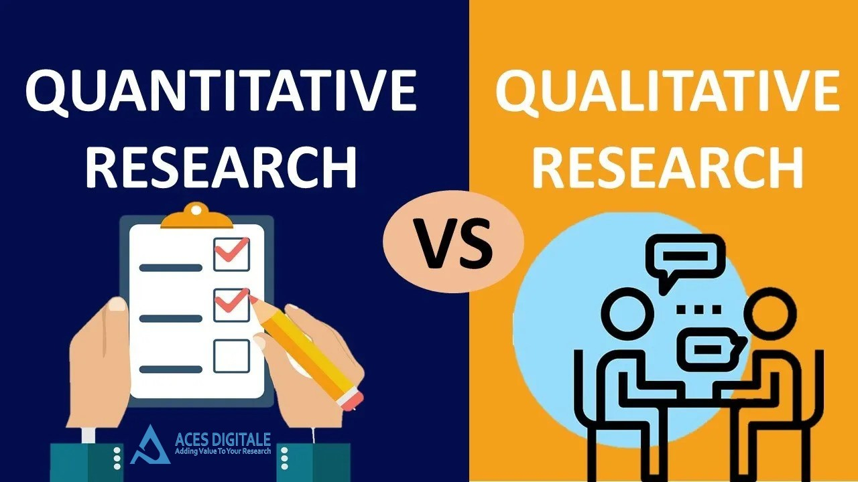
Qualitative Method
Impacts of Economic Sanctions on Population Health and Health System
Step | Description | Tools and Techniques
1. Participant Selection | - Patients: Selected 31 individuals with chronic or rare diseases from provinces with different socio-economic statuses (Tehran, Sistan-Baluchestan, Yazd). - Policymakers: 8 health experts with expertise in sanctions, resource allocation, and public health. | - Stratified sampling. - Data from the Health Insurance Organization and expert networks.
2. Data Collection | - Conducted semi-structured interviews. - Patients: Focused on healthcare access, costs, and challenges. - Policymakers: Discussed sanctions’ effects on governance and system functioning. | - Interview guides tailored for each group. - Telephone interviews (patients) and in-person interviews (policymakers).
3. Ethical Considerations | - Ensured participant privacy and confidentiality. - Obtained informed consent for participation and recording. | - Ethical approval from research board. - Secure data storage protocols.
4. Data Analysis | - Applied content analysis to identify recurring themes and sub-themes. - Categorized themes into broader concepts like "Access Challenges" or "System Resilience." | - MAXQDA software for coding and analysis. - Triangulation for validation.
1
1
1
1
Background
1
Background
2
2
2
2
Methods
2
Methods
Methods
3
2
3
3
Results
3
Results
4
4
4
4
Discussion
4
Discussion
5
5
5
5
Conclusion
5
Conclusion
6
6
Recommendations
Recommendations

Slide 14
Section 3: Results

Slide 15
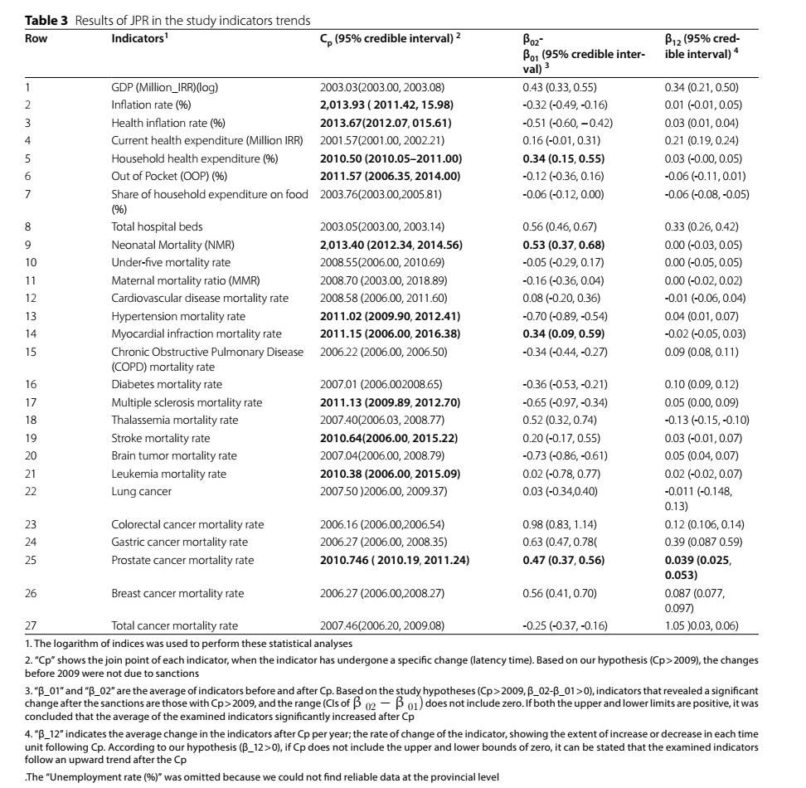
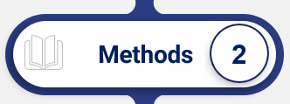
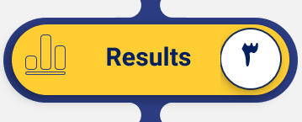
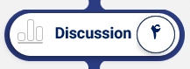
Results- Overview of Quantitative Findings
Impacts of Economic Sanctions on Population Health and Health System
1
1
1
1
1
Background
1
Background
Background
2
2
2
2
2
Methods
2
Methods
Methods
Methods
3
2
3
3
3
Results
3
Results
Results
4
4
4
4
4
Discussion
4
Discussion
Discussion
5
5
5
5
5
Conclusion
5
Conclusion
Conclusion
6
6
Recommendations
Recommendations
Recommendations

Slide 16
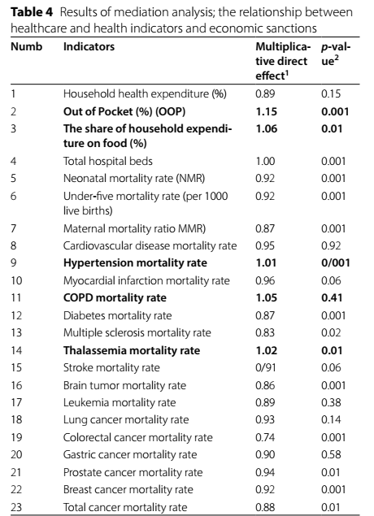
Results- Overview of Quantitative Findings
Impacts of Economic Sanctions on Population Health and Health System
1
1
1
1
Background
1
Background
2
2
2
2
Methods
2
Methods
3
3
3
3
Results
3
Results
4
4
4
4
Discussion
4
Discussion
5
5
5
5
Conclusion
5
Conclusion
6
6
Recommendations
Recommendations

Slide 17
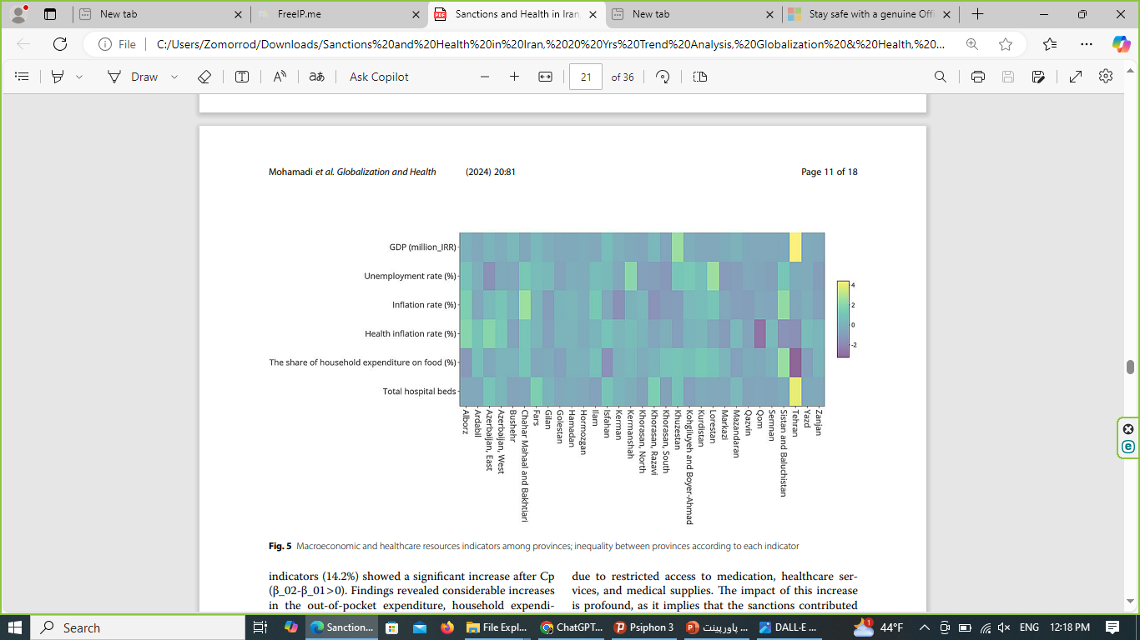
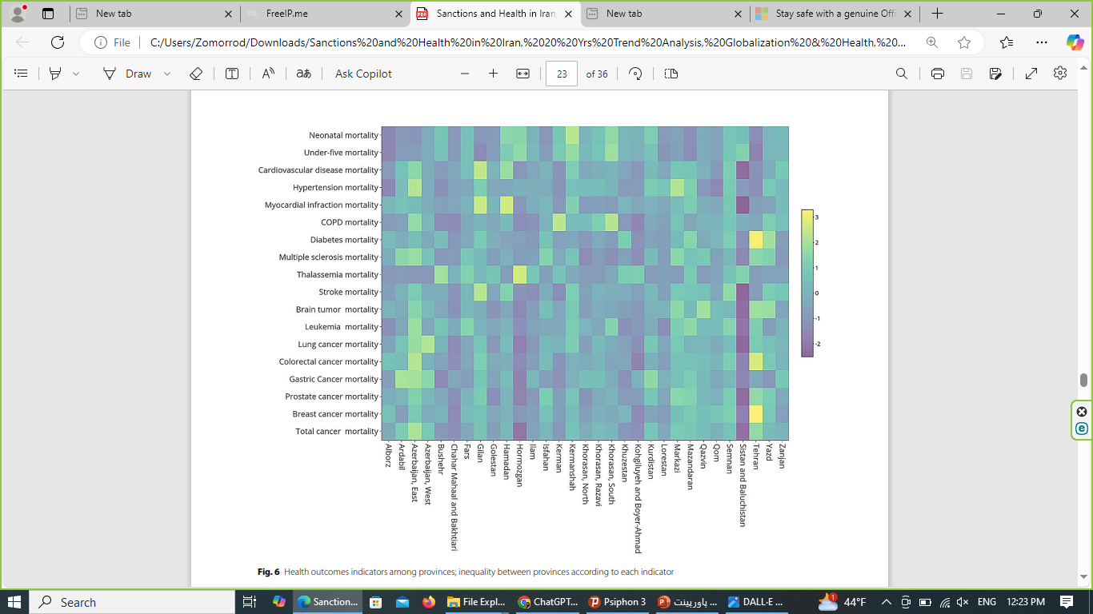
Results- Overview of Quantitative Findings
Impacts of Economic Sanctions on Population Health and Health System
Provincial Disparities in Healthcare
Regional Disparities in Healthcare Expenditure: The findings highlighted significant inequalities in healthcare-related expenditure across provinces. For instance, regions like Sistan and Baluchestan faced higher food expenditures, suggesting they were more vulnerable to the economic impacts of sanctions.
Cardiovascular Disease and Thalassemia Mortality: There were notable regional inequalities in mortality rates from cardiovascular diseases and thalassemia. Disparities in healthcare outcomes were more pronounced in poorer regions with fewer resources.
Inequality in Health Outcomes: While there were some variations in cancer mortality rates, they were less pronounced compared to the inequalities in cardiovascular and thalassemia mortality rates across different provinces.
1
1
1
Background
1
2
2
2
Methods
2
3
3
3
Results
3
4
4
4
Discussion
4
5
5
5
Conclusion
5
6
6
Recommendations

Slide 18
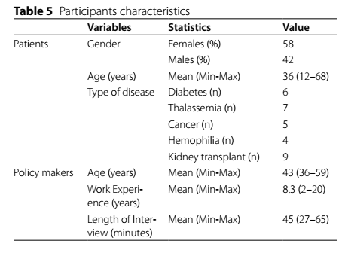
Results- Overview of Qualitative Findings
Impacts of Economic Sanctions on Population Health and Health System
1
1
1
1
Background
1
Background
2
2
2
2
Methods
2
Methods
3
3
3
3
Results
3
Results
4
4
4
4
Discussion
4
Discussion
5
5
5
5
Conclusion
5
Conclusion
6
6
Recommendations
Recommendations

Slide 19
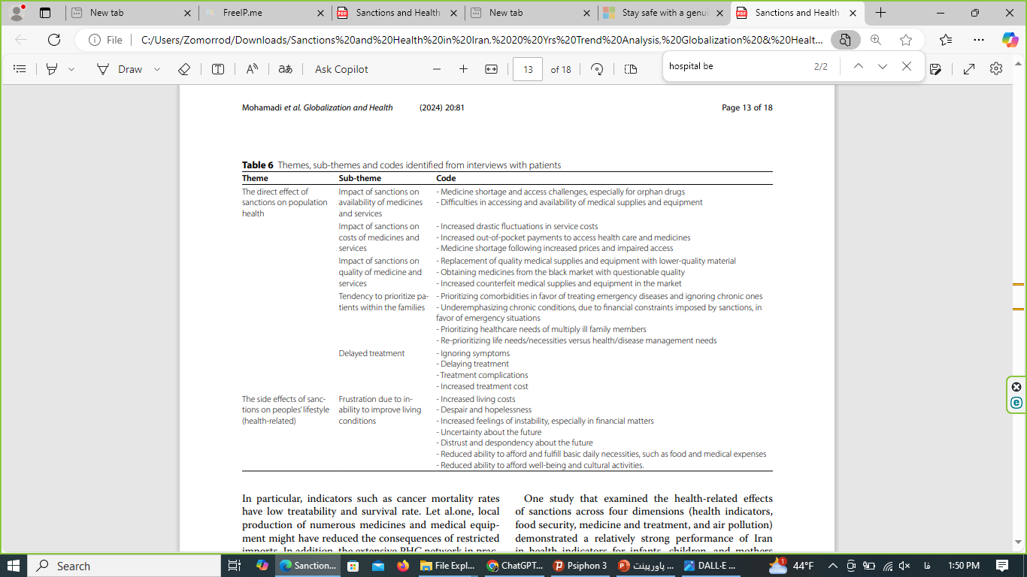
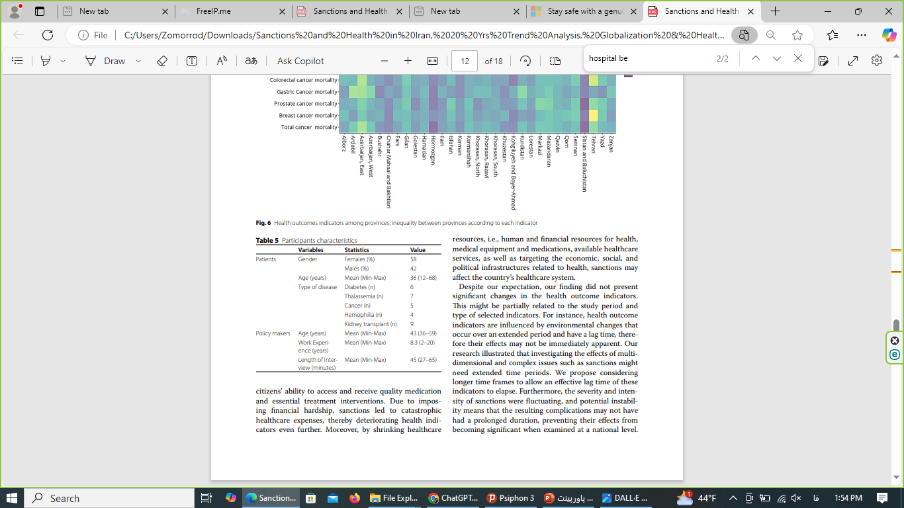
Results- Overview of Qualitative Findings – Patients
Impacts of Economic Sanctions on Population Health and Health System
1
1
1
1
Background
1
Background
2
2
2
2
Methods
2
Methods
3
3
3
3
Results
3
Results
4
4
4
4
Discussion
4
Discussion
5
5
5
5
Conclusion
5
Conclusion
6
6
Recommendations
Recommendations

Slide 20
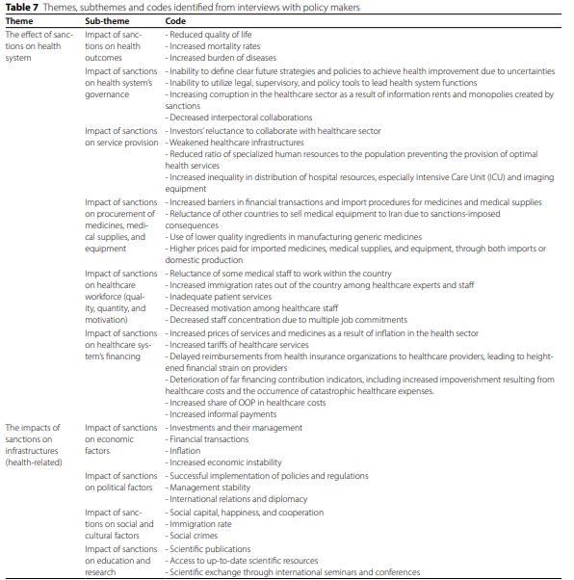
Results- Overview of Qualitative Findings – Policymakers
Impacts of Economic Sanctions on Population Health and Health System
1
1
1
1
Background
1
Background
2
2
2
2
Methods
2
Methods
3
3
3
3
Results
3
Results
4
4
4
4
Discussion
4
Discussion
5
5
5
5
Conclusion
5
Conclusion
6
6
Recommendations
Recommendations

Slide 21
Section 4: Discussion

Slide 22
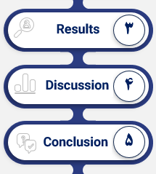
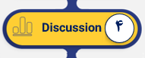
Discussion
Impacts of Economic Sanctions on Population Health and Health System
Key Findings from the Article | Causes Identified | Related Studies
Increased Healthcare Costs: - A 15% increase in out-of-pocket (OOP) payments for households, especially for essential medicines. - Household expenses on food and medicine have risen significantly, creating limitations on chronic disease treatment. Medicine and Equipment Shortages: - A reduction in medicine and medical equipment imports due to financial and trade restrictions, leading to serious disruptions in healthcare access. - Patients with chronic diseases such as COPD, diabetes, and thalassemia suffered from a lack of essential medicines. | - The decline in the value of the rial, problems related to international financial transactions, and the rising inflation rate in the healthcare sector. - Sanctions limited Iran's economic resources and its ability to procure essential medicines and medical equipment. | - Ebrahimi et al. (2024): Similar issues have been observed in other sanctioned countries, where these restrictions caused disruptions in medicine and medical equipment supply.
Increased Mortality Rates: - A rise in mortality rates for chronic diseases such as COPD and hypertension. - Neonatal mortality, particularly in rural areas, increased due to lack of access to emergency and preventive services. Maternal and Child Health Impact: - A rise in maternal and neonatal mortality, especially in underdeveloped provinces (such as Sistan-Baluchestan and Khuzestan), where access to healthcare services had been reduced. | - Shortages of medicines and medical equipment for chronic disease treatment and mortality prevention. - Economic problems arising from sanctions, which affected the ability of households to afford healthcare costs. | - Sajadi et al. (2023): Reports similar effects of sanctions on non-communicable disease mortality and reduced access to medications in Iran.
1
1
1
Background
1
2
2
2
Methods
2
3
3
3
Results
3
4
4
4
Discussion
4
5
5
5
Conclusion
5
6
6
Recommendations
Notes:
عوامل مؤثر بر صنعت تجهیزات پزشکی:
کشورهای توسعه‌یافته: هزینه‌های زیاد مراقبت‌های بهداشتی، سیاست‌های بازپرداخت مطلوب و زیرساخت‌های پیشرفته موجب افزایش درآمد و ارزش بازار تجهیزات پزشکی شده است. همچنین، افزایش جمعیت سالخورده و شیوع بیماری‌های مزمن به افزایش استفاده از تجهیزات پزشکی کمک کرده است.
کشورهای نوظهور: مانند چین و هند، با عواملی چون افزایش جمعیت، بهبود زیرساخت‌های بهداشتی و درمانی و افزایش آگاهی مردم، تقاضا برای تجهیزات پزشکی و هزینه‌های بهداشتی افزایش یافته است.
کشورهای در حال توسعه: وابستگی بالایی به فناوری‌های پزشکی وارداتی دارند به دلیل کمبود منابع مالی و پرسنل آموزش‌دیده. این تجهیزات پیشرفته معمولاً هزینه زیادی را به کشورها تحمیل می‌کند و ممکن است عملکردهای اضافی آن‌ها در کشورهای در حال توسعه به خوبی استفاده نشود.
این نتایج نشان‌دهنده روند رو به رشد صنعت تجهیزات پزشکی در سطح جهانی و به ویژه در ایران و کشورهای نوظهور است. همچنین، چالش‌های وابستگی به فناوری‌های پیشرفته در کشورهای در حال توسعه به وضوح مشخص شده است.
نتایج کلی:
تحریم‌ها و اقتصادی:
تحریم‌های اقتصادی و تغییرات قیمت ارز تأثیر عمیق و منفی بر صنعت تجهیزات پزشکی ایران داشته است.
کاهش شدید واردات در سال‌های 1397 و 1398 به دلیل فشارهای اقتصادی و تحریم‌ها.
کرونا:
شیوع کووید-19 در سال 1399 موجب کاهش شدید واردات تجهیزات پزشکی به دلیل اختلال در زنجیره تأمین و افزایش تقاضا شد.
بهبود نسبی وضعیت زنجیره تأمین و افزایش واردات در سال 1400.
سیاست‌های ارزی:
سیاست‌های ارزی و تغییرات در تخصیص ارز دولتی و یارانه نقدی تأثیر قابل توجهی بر واردات و قیمت تجهیزات پزشکی داشته است.
حذف ارز ترجیحی و افزایش یارانه نقدی به کاهش واردات در سال 1401 منجر شد.
پیشرفت‌های داخلی:
تلاش برای تقویت تولید داخلی به عنوان یک راهکار برای کاهش وابستگی به واردات و مقابله با اثرات تحریم‌ها و بحران‌ها.

Slide 23
Discussion
Impacts of Economic Sanctions on Population Health and Health System
Key Findings from the Article | Causes Identified | Related Studies
Provincial Disparities: - Provinces such as Sistan-Baluchestan and Kurdistan faced the highest impact from sanctions and had the least access to healthcare services. - In contrast, Tehran and Isfahan, with better infrastructure and more resources, experienced fewer negative effects. Healthcare Access Inequalities: - Unequal access to hospital beds, medicines, and mental health services in deprived provinces. - High share of healthcare costs from household income in these areas. | - Unequal distribution of healthcare resources, reduced investment in underserved areas, and weak healthcare infrastructure at the provincial level. | - Khosravi et al. (2023): Examined regional inequalities in healthcare access in Iran and other similarly sanctioned countries.
Increased Mental Health Issues: - Rising anxiety, depression, and stress caused by financial concerns and limited access to appropriate healthcare services. - Increased mental health issues among low-income households, which are under economic pressure. Social Impact: - Public dissatisfaction and reduced confidence due to rising prices and limited access to essential services. | Economic difficulties, especially for low-income households, which are unable to afford daily living and healthcare costs. Lack of resources for psychotherapy and counseling services in underserved areas.. | - Giotakos (2010): A similar study in Greece showed that economic crises led to increased mental health disorders in society.
1
1
1
Background
1
2
2
2
Methods
2
3
3
3
Results
3
4
4
4
Discussion
4
5
5
5
Conclusion
5
6
6
Recommendations
Notes:
عوامل مؤثر بر صنعت تجهیزات پزشکی:
کشورهای توسعه‌یافته: هزینه‌های زیاد مراقبت‌های بهداشتی، سیاست‌های بازپرداخت مطلوب و زیرساخت‌های پیشرفته موجب افزایش درآمد و ارزش بازار تجهیزات پزشکی شده است. همچنین، افزایش جمعیت سالخورده و شیوع بیماری‌های مزمن به افزایش استفاده از تجهیزات پزشکی کمک کرده است.
کشورهای نوظهور: مانند چین و هند، با عواملی چون افزایش جمعیت، بهبود زیرساخت‌های بهداشتی و درمانی و افزایش آگاهی مردم، تقاضا برای تجهیزات پزشکی و هزینه‌های بهداشتی افزایش یافته است.
کشورهای در حال توسعه: وابستگی بالایی به فناوری‌های پزشکی وارداتی دارند به دلیل کمبود منابع مالی و پرسنل آموزش‌دیده. این تجهیزات پیشرفته معمولاً هزینه زیادی را به کشورها تحمیل می‌کند و ممکن است عملکردهای اضافی آن‌ها در کشورهای در حال توسعه به خوبی استفاده نشود.
این نتایج نشان‌دهنده روند رو به رشد صنعت تجهیزات پزشکی در سطح جهانی و به ویژه در ایران و کشورهای نوظهور است. همچنین، چالش‌های وابستگی به فناوری‌های پیشرفته در کشورهای در حال توسعه به وضوح مشخص شده است.
نتایج کلی:
تحریم‌ها و اقتصادی:
تحریم‌های اقتصادی و تغییرات قیمت ارز تأثیر عمیق و منفی بر صنعت تجهیزات پزشکی ایران داشته است.
کاهش شدید واردات در سال‌های 1397 و 1398 به دلیل فشارهای اقتصادی و تحریم‌ها.
کرونا:
شیوع کووید-19 در سال 1399 موجب کاهش شدید واردات تجهیزات پزشکی به دلیل اختلال در زنجیره تأمین و افزایش تقاضا شد.
بهبود نسبی وضعیت زنجیره تأمین و افزایش واردات در سال 1400.
سیاست‌های ارزی:
سیاست‌های ارزی و تغییرات در تخصیص ارز دولتی و یارانه نقدی تأثیر قابل توجهی بر واردات و قیمت تجهیزات پزشکی داشته است.
حذف ارز ترجیحی و افزایش یارانه نقدی به کاهش واردات در سال 1401 منجر شد.
پیشرفت‌های داخلی:
تلاش برای تقویت تولید داخلی به عنوان یک راهکار برای کاهش وابستگی به واردات و مقابله با اثرات تحریم‌ها و بحران‌ها.

Slide 24

Discussion
Impacts of Economic Sanctions on Population Health and Health System
Key Findings from the Article | Causes Identified | Related Studies
Healthcare System Resilience: - Iran’s healthcare system demonstrated strong resilience through primary healthcare infrastructure and was able to mitigate some of the negative effects of sanctions. - Programs like the Family Physician Program and Rural Health Insurance helped reduce the impact of sanctions on healthcare access. Limitations of Resilience: - The low quality of domestic products and the lack of resources to produce high-quality medicines and medical equipment. | - Iran's public health system has shown significant resilience in the face of economic pressures caused by sanctions, but challenges remain in ensuring the supply of resources and healthcare professionals. | - Takian et al. (2020): Highlighted the resilience of Iran’s health system in the face of sanctions and the challenges it continues to face in terms of resource supply and capacity.
1
1
1
Background
1
2
2
2
Methods
2
3
3
3
Results
3
4
4
4
Discussion
4
5
5
5
Conclusion
5
6
6
Recommendations
Notes:
عوامل مؤثر بر صنعت تجهیزات پزشکی:
کشورهای توسعه‌یافته: هزینه‌های زیاد مراقبت‌های بهداشتی، سیاست‌های بازپرداخت مطلوب و زیرساخت‌های پیشرفته موجب افزایش درآمد و ارزش بازار تجهیزات پزشکی شده است. همچنین، افزایش جمعیت سالخورده و شیوع بیماری‌های مزمن به افزایش استفاده از تجهیزات پزشکی کمک کرده است.
کشورهای نوظهور: مانند چین و هند، با عواملی چون افزایش جمعیت، بهبود زیرساخت‌های بهداشتی و درمانی و افزایش آگاهی مردم، تقاضا برای تجهیزات پزشکی و هزینه‌های بهداشتی افزایش یافته است.
کشورهای در حال توسعه: وابستگی بالایی به فناوری‌های پزشکی وارداتی دارند به دلیل کمبود منابع مالی و پرسنل آموزش‌دیده. این تجهیزات پیشرفته معمولاً هزینه زیادی را به کشورها تحمیل می‌کند و ممکن است عملکردهای اضافی آن‌ها در کشورهای در حال توسعه به خوبی استفاده نشود.
این نتایج نشان‌دهنده روند رو به رشد صنعت تجهیزات پزشکی در سطح جهانی و به ویژه در ایران و کشورهای نوظهور است. همچنین، چالش‌های وابستگی به فناوری‌های پیشرفته در کشورهای در حال توسعه به وضوح مشخص شده است.
نتایج کلی:
تحریم‌ها و اقتصادی:
تحریم‌های اقتصادی و تغییرات قیمت ارز تأثیر عمیق و منفی بر صنعت تجهیزات پزشکی ایران داشته است.
کاهش شدید واردات در سال‌های 1397 و 1398 به دلیل فشارهای اقتصادی و تحریم‌ها.
کرونا:
شیوع کووید-19 در سال 1399 موجب کاهش شدید واردات تجهیزات پزشکی به دلیل اختلال در زنجیره تأمین و افزایش تقاضا شد.
بهبود نسبی وضعیت زنجیره تأمین و افزایش واردات در سال 1400.
سیاست‌های ارزی:
سیاست‌های ارزی و تغییرات در تخصیص ارز دولتی و یارانه نقدی تأثیر قابل توجهی بر واردات و قیمت تجهیزات پزشکی داشته است.
حذف ارز ترجیحی و افزایش یارانه نقدی به کاهش واردات در سال 1401 منجر شد.
پیشرفت‌های داخلی:
تلاش برای تقویت تولید داخلی به عنوان یک راهکار برای کاهش وابستگی به واردات و مقابله با اثرات تحریم‌ها و بحران‌ها.

Slide 25
Challenges and Limitations
Impacts of Economic Sanctions on Population Health and Health System
Challenges and Limitations
Quantitative Challenges
Longer Observation Needed: More time may be required to fully measure sanctions' impact on health indicators.
Causal Complexity: It's challenging to isolate sanctions' effects from other factors like health reforms and the epidemiologic transition.
Confounding Variables: Uncontrolled variables, such as regional conflicts or healthcare reforms, affect the validity of results.
Linearity Assumption in JPR Model: The JPR model may miss non-linear or delayed responses; alternative models could offer more insights.
Attribution to Sanctions: It's difficult to attribute health changes solely to sanctions due to other influencing factors.
Provincial Data Variability: Differences in data quality across provinces make it hard to draw consistent conclusions.
Health and Sanctions Interactions: Multiple interconnected factors complicate isolating the effect of sanctions on health.
Sample Size and Diversity: The small sample size (e.g., 8 policymakers) limits the diversity of perspectives.
Self-Reporting Bias: Participants' personal circumstances or memory recall may introduce bias in interviews.
Qualitative Challenges
Overall Challenges
Confounding Variables: Both quantitative and qualitative parts struggle with controlling confounding factors.
Logistical Constraints: COVID-19 restrictions limited face-to-face interviews, affecting the depth of qualitative findings and the broader study.
1
1
1
Background
1
2
2
2
Methods
2
3
3
3
Results
3
4
4
4
Discussion
4
5
5
5
Conclusion
5
6
6
Recommendations

Slide 26
Section 5: Conclusions

Slide 27
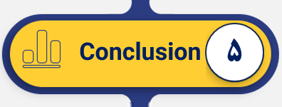
Conclusion – Impact of Sanctions on Public Health in Iran
Impacts of Economic Sanctions on Population Health and Health System
Study Aim
This study investigated the impact of sanctions on key health indicators reflecting the health status of the population in Iran.
The Main Key Findings
Increased Healthcare Costs:
Significant rise in out-of-pocket (OOP) payments for households.
Increased financial burden on families due to higher healthcare and medication costs.
Worsened Health Outcomes:
Chronic disease patients experienced deteriorating health outcomes due to lack of access to essential medicines.
The growing financial burden on households exacerbated these health challenges.
Regional Inequalities in Healthcare Access:
Significant disparities in healthcare access across provinces, especially in rural and underdeveloped areas.
Significant Changes in Health Indicators:
11 indicators (39.2%) showed changes after the change point in 2009, with four indicators (14.2%) significantly deteriorating post-2009.
Five indicators demonstrated significant increases during the sanctions period:
Out-of-Pocket (OOP) payments, household expenditure on food, and mortality rates due to COPD, thalassemia, and hypertension.
Indirect Effects of Sanctions:
Sanctions resulted in inflation, reduced production, currency devaluation, and difficult financial transactions with other countries.
Political behavior changes and diplomatic relations also played a role in impacting public health.
Challenges Identified by Patients:
Patients identified availability, cost, and quality of medicines and healthcare services as the most significant challenges compromising population health.
Challenges Identified by Policymakers:
Policymakers highlighted the effect of sanctions on the health system’s functions and infrastructures, including economic, political, social, educational, and research sectors. These had significant repercussions on population health.
1
1
1
Background
1
2
2
2
Methods
2
3
3
3
Results
3
4
4
4
Discussion
4
5
5
5
Conclusion
5
6
6
Recommendations

Slide 28

Conclusion – Impact of Sanctions on Public Health in Iran
Impacts of Economic Sanctions on Population Health and Health System
We found no strong evidence linking sanctions directly to trends in population health.
However, our qualitative study revealed worsening life experiences, such as increased catastrophic health expenditures and limited access to essential medicines and healthcare services, which ultimately reduced quality of life.
Sanctions appear to have negatively impacted financial and physical access to healthcare.
Despite these challenges, Iran’s healthcare system demonstrated remarkable resilience, likely due to its strong economic infrastructure and healthcare network.
1
1
1
Background
1
2
2
2
Methods
2
3
3
3
Results
3
4
4
4
Discussion
4
5
5
5
Conclusion
5
6
6
Recommendations

Slide 29
Section 6: Recommendations

Slide 30
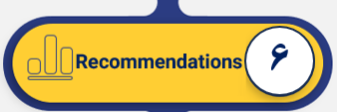
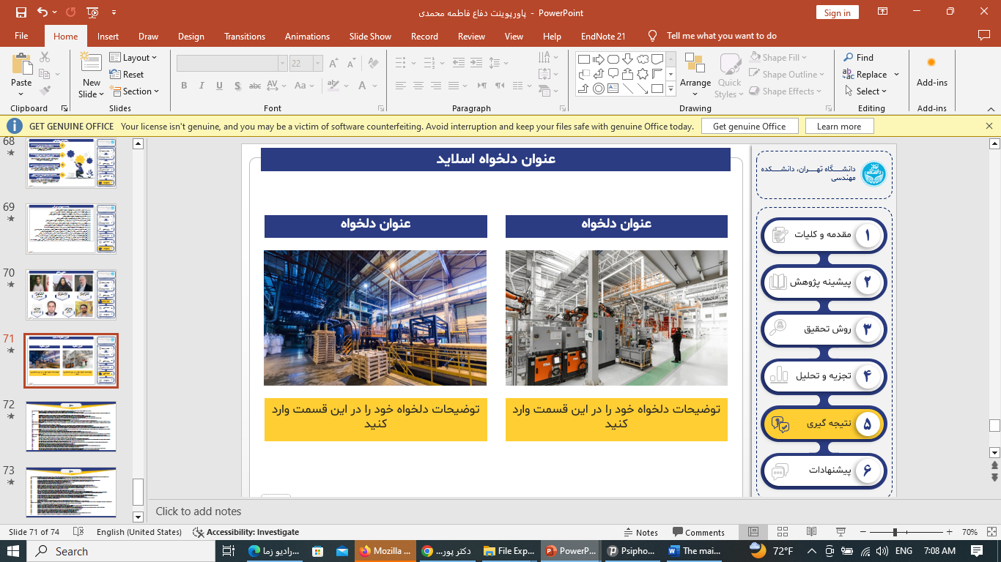
Policy Recommendations for Mitigating Sanction Effects
Impacts of Economic Sanctions on Population Health and Health System
1
Promote Generic Medicines and Improve Quality:
Increase production of high-quality generic medicines and reduce reliance on imported foreign drugs.
Reforms in the regulatory system to control the quality of domestically produced medicines and enhance their credibility in the market.
Improve the production processes of essential domestic medicines to reduce costs and meet patients' needs, especially during sanctions.
1
1
1
Background
1
2
2
2
Methods
2
2
Develop Sustainable Financial Mechanisms for Medicines and Medical Equipment:
The need for sustainable financial structures based on both public and private support to secure necessary resources for importing and producing medicines and medical equipment.
Establishment of national and international funds to cover medication and medical costs during crisis situations.
3
3
3
Results
3
4
4
4
Discussion
4
3
5
5
5
Promotion of Rational Medicine Use:
Educational campaigns and awareness programs regarding the rational use of medicines, particularly painkillers and antibiotics, to prevent misuse.
Encouragement of prescribing generic medicines instead of branded drugs to reduce costs and increase patient access to medications.
Conclusion
5
6
Recommendations
6

Slide 31
Policy Recommendations for Mitigating Sanction Effects
Impacts of Economic Sanctions on Population Health and Health System
Improve Healthcare Infrastructure:
Strengthening healthcare and treatment infrastructure in underdeveloped provinces and reducing the gap between large cities and remote areas.
Investing in hospitals and treatment centers in rural and remote areas to increase access to healthcare services.
4
1
1
1
Background
1
Enhance Training and Retention of Health Workers:
Educational programs for health workers to improve technical and professional skills in crisis conditions.
Offering incentives to attract and retain healthcare workers in underserved areas by improving working conditions and salaries.
2
2
2
5
Methods
2
3
3
3
Results
3
4
4
4
Discussion
4
6
Collaboration with International Bodies for Essential Medicine Supply:
Collaboration with the World Health Organization (WHO) and other international organizations for the supply of essential medicines and medical equipment during sanctions.
Utilization of international humanitarian support to import essential medicines and advanced medical equipment into the country.
Facilitating drug exchanges through international laws that allow for countries under sanctions.
Strengthening regional cooperation with neighboring countries in pharmaceutical production and exchanging healthcare resources.
Leveraging the experiences of other countries facing similar sanctions to improve healthcare conditions.
5
5
5
Conclusion
5
6
Recommendations
6

Slide 32
Strengths & innovation of the Study
Impacts of Economic Sanctions on Population Health and Health System
Comprehensive Coverage
Long-Term Analysis: Covered two decades (2000–2020) of healthcare trends under sanctions.
Geographical Scope:Analyzed data at both national and sub-national levels, highlighting disparities across provinces.
Innovative Mixed-Methods Design
Integration of Methods: Combined quantitative trends with qualitative insights for a more nuanced understanding.
Robust Quantitative Techniques: Use of advanced statistical models like Join Point Regression and GAMM to detect trends and relationships.
Rich Qualitative Insights: Semi-structured interviews provided in-depth perspectives from diverse participants.
Policy Relevance
Identified Inequities: Highlighted regions and populations most affected by sanctions, guiding targeted interventions.
Actionable Recommendations: Provided evidence-based insights for mitigating sanctions' adverse effects on healthcare.
Interdisciplinary Approach
Bridged health economics, public policy, and qualitative research to address a complex issue comprehensively.
1
1
1
1
Background
1
Background
2
2
2
2
Methods
2
Methods
Methods
3
2
3
3
Results
3
Results
4
4
4
4
Discussion
4
Discussion
5
5
5
5
Conclusion
5
Conclusion
6
6
Recommendations
Recommendations
Notes:
ساختار بازار رقابت کامل: در این حالت، بیش از 50 رقیب در بازار وجود دارند بدون آنکه سهم زیادی از بازار را در اختیار داشته باشند.
ساختار بازار رقابت انحصاری: تعداد بنگاه های رقیب موثر زیاد بوده و هیچکدام بیش از 10 درصد بازار را در انحصار ندارند.
ساختار بازار انحصار چند جانبه باز: در این حالت 4 بنگاه، حداکثر 40 درصد بازار را در انحصار خودشان دارند.
ساختار بازار انحصار چند جانبه: 4 بنگاه، حداقل 40 درصد و حداکثر 60 درصد بازار را در انحصار دارند.
ساختار بازار انحصار چند جانبه بسته: 4 بنگاه، حداقل 60 درصد بازار را در انحصار دارند.
ساختار بازار بنگاه مسلط: در این حالت یک بنگاه به تنهایی بیشتر از 50 درصد از سهام بازار را در انحصار خود دارد.
ساختار بازار انحصار کامل: در این نوع بازار، یک بنگاه کل بازار را در انحصار خودش دارد.
Competitive market
Monopolistic competition
Open (Loose) oligopoly
Oligopoly
Closed (Tight) oligopoly
Dominant firm
Monopoly
از این رو رقابت کامل مفیدترین نوع ساختار بازار می باشد. زیرا در این حالت، تقاضای واقعی مشتریان مشخص است و عرضه کنندگان محصولات خودشان را با سطح قیمت و کیفیتی که خریدار می خواهد، به گونه ای که هزینه های فروشنده نیز تامین گردد، ارائه خواهند کرد. به معنای دیگر، در این حالت علایق تولیدکنندگان و مصرف کنندگان با یکدیگر هم سطح شده و موجب می گردد تا فروشندگان هزینه های واقعی خودشان را آشکار نمایند (جدول 2-3).
جدول2-3- انواع ساختار بازار اصلی و ویژگی های آن (35, 88-91)
ویژگی
انحصار کامل
(Monopoly)
انحصار چند جانبه (Oligopoly)
رقابت انحصاری (Monopolistic competition)
رقابت کامل (Competitive market)
تعداد شرکت ها
یک
2 یا بیشتر
بسیار زیاد
بسیار زیاد
اندازه متوسط شرکت ها
بسیار بزرگ
بزرگ
کوچک تا متوسط
کوچک کمی
ماهیت محصول
منحصر به فرد خاص به فرد
مشابه / متمایز
متمایز
یکسان
موانع ورود
قابل توجه
قابل توجه
کم
بدون
دخالت دولت
بله
برخی
خیر
خیر
تصمیمات خروجی
بیشترین خروجی
خروجی محدود
خروجی محدود
بدون محدودیت خروجی
وابستگی متقابل
بدون رقیب
رقبای وابسته
هر شرکت مستقل است
هر شرکت مستقل است
امکان سودآوری
بالا
بالا
متوسط
پایین
قیمت و هزینه نهایی
هزینه نهایی >قیمت
هزینه نهایی >قیمت
هزینه نهایی >قیمت
قیمت = هزینه نهایی

Slide 33
Key Recommendations for Future Research
Impacts of Economic Sanctions on Population Health and Health System
Longer Observation Period
Future research should consider a longer observation period to capture delayed effects of sanctions on health outcomes, especially given the complexity and variability of sanctions over time.
Focus on Intermediate and Process Indicators
Research should focus on intermediate indicators like healthcare access and service quality, rather than only health outcomes, to better understand the mechanisms of sanctions' impact.
Sub-national Disparities
There is a need to explore regional differences in the impact of sanctions, as sanctions may exacerbate existing inequalities in healthcare access between provinces.
1
1
1
Background
1
2
2
2
Methods
2
3
3
3
Results
3
Integration of Multiple Factors
Future studies should incorporate multiple variables (economic, political, social) to understand how sanctions interact with broader health determinants and affect overall health outcomes.
Healthcare Workforce Issues
Research should investigate how sanctions impact the healthcare workforce, including migration, staffing shortages, and changes in professional motivations, as these factors affect healthcare delivery.
Comparative Studies with Other Countries
Conducting comparative studies with other nations under similar sanctions could provide insights into common challenges and effective policy responses to mitigate the health impacts of sanctions.
4
4
4
Discussion
4
5
5
5
Conclusion
5
6
Recommendations
6

Slide 34
References
Katzman K. Iran sanctions. Congressional Research Service Washington, DC; 2011.
Pakdaman M, Geravandi S, Askari R, Askarishahi M, Afzali HR. The effect of macroeconomic indicators on healthcare expenditure in Iran. J Educ Health Promotion. 2019;8.
Setayesh S, Mackey TK. Addressing the impact of economic sanctions on Iranian drug shortages in the joint comprehensive plan of action: promoting access to medicines and health diplomacy. Globalization Health. 2016;12(1):1–14.
Massoumi RL, Koduri S. Adverse effects of political sanctions on the health care system in Iran. J Global Health. 2015;5(2).
Mohammadi D. US-led economic sanctions strangle Iran’s drug supply. Lancet. 2013;381(9863):279.
Namazi S. Sanctions and medical supply shortages in Iran. Viewpoints. 2013;20:1–9.
Butler D. Iran hit by drug shortage: sanctions cause increasing shortfall in medicines and vaccines. Nature. 2013;504(7478):15–7.
Golzari S, Ghabili K, Khanli HM, Tizro P, Rikhtegar R. Access to cancer medicine in Iran. Chemotherapy. 2013;3:5.
Hashemi-Meshkini A. Making the public health and industrial objectives balanced; the big challenge of Iran’s food and drug organization. Iran J Public Health. 2014;43(5):693.
Farzadfar F, Naghavi M, Sepanlou SG, Moghaddam SS, Dangel WJ, Weaver ND, et al. Health system performance in Iran: a systematic analysis for the global burden of Disease Study 2019. Lancet. 2022;399(10335):1625–45.
Forouzanfar MH, Sepanlou SG, Shahraz S, Dicker D, Naghavi P, Pourmalek F, et al. Evaluating causes of death and morbidity in Iran, global burden of diseases, injuries, and risk factors study 2010. Arch Iran Med. 2014;17(5):0.
Farhood B, Geraily G, Alizadeh A. Incidence and mortality of various cancers in Iran and compare to other countries: a review article. Iran J Public Health. 2018;47(3):309.
Sajadi HS, Majdzadeh R. Health system to respond to economic sanctions: global evidence and lessons learned from Iran. Globalization Health. 2022;18(1):107.
Danaei G, Harirchi I, Sajadi HS, Yahyaei F, Majdzadeh R. The harsh effects of sanctions on Iranian health. Lancet. 2019;394(10197):468–9.
Gorji A. Sanctions against Iran: the impact on health services. 2014.
Mohamadi E, Takian A, Olyaeemanesh A, Rashidian A, Hassanzadeh A, Razavi M, et al. Health insurance benefit package in Iran: a qualitative policy process analysis. BMC Health Serv Res. 2020;20(1):1–13.
Duttagupta S, Yampolsky D, Chowdhury C. Economic sanctions and market access for pharmaceuticals: case studies with Russia, Cuba and Iran. Value Health. 2015;18(7):A569.
Ghalibafian M, Hemmati S, Bouffet E. The silent victims of the US embargo against Iran. Lancet Oncol. 2018;19(11):e580.
Asgardoon MH, Hosein M. Adverse impacts of imposing international economic sanctions on health. Arch Iran Med. 2022;25(3):182–90.
Hajizadeh M, Nghiem HS. Hospital care in Iran: an examination of national health system performance. Int J Healthc Manag. 2013;6(3):201–10.
Sajadi HS, Yahyaei F, Ehsani-Chimeh E, Majdzadeh R. The human cost of economic sanctions and strategies for building health system resilience: a scoping review of studies in Iran. Int J Health Plann Manag. 2023.
Pintor MP, Suhrcke M, Hamelmann C. The impact of economic sanctions on health and health systems in low-income and middle-income countries: a systematic review and narrative synthesis. BMJ Global Health. 2023;8(2):e010968.
Masoodi M, Rahimzadeh M. Measuring access to urban health services using Geographical Information System (GIS): a case study of health service management in Bandar Abbas, Iran. Int J Health Policy Manage. 2015;4(7):439.
Ebrahimi F, Kraemer A, Mohamadi E, Kiani MM, Majdzadeh R, Mohamadzade M, et al. Study protocol for investigating the Impact of Economic Sanctions on Public Health and Healthcare Systems in Iran: A National and sub-national analysis from 2000 to 2020. Health Scope. 2024;13(3):e134234.
Kiani MM, Mostafavi H, Ebrahimi F, Majdzadeh R, Mohamadi E, Kraemer A, et al. The experiences and perceptions of people with chronic and rare diseases during political-economic sanctions in Iran: a qualitative study. BMC Health Serv Res. 2024;24(1):276.

Slide 35
References
Doshmangir L, Bazyar M, Majdzadeh R, Takian A. So near, so far: four decades of health policy reforms in Iran, achievements and challenges. Arch Iran Med. 2019;22(10):592–605.
Claborn DM. A narrative review of the role of economic crisis on health and healthcare infrastructure in three disparate national environments. Int J Environ Res Public Health. 2020;17(4):1252.
Giotakos O. Financial crisis and mental health. Psychiatrike = Psychiatriki. 2010;21(3):195–204.
Ghiasvand H, Mohamadi E, Olyaeemanesh A, Kiani MM, Armoon B, Takian A. Health equity in Iran: a systematic review. Med J Islamic Repub Iran. 2021;35:51.
Mehryar AH, Ahmad-Nia S, Kazemipour S. Reproductive health in Iran: pragmatic achievements, unmet needs, and ethical challenges in a theocratic system. Stud Fam Plann. 2007;38(4):352–61.
Damghanian M, Shariati M, Mirzaiinajmabadi K, Yunesian M, Emamian MH. Socioeconomic inequality and its determinants regarding infant mortality in Iran. Iran Red Crescent Med J. 2014;16(6).
Khosravi A, Mohamadi E, Sheidaei A, Shafiee G, Heshmat R, Olyaeemanesh A, et al. Child mortality inequalities and socioeconomic determinants of health in Iran, 2016–2018. J Public Health Policy. 2023;44(4):535–50.
Moret ES. Humanitarian impacts of economic sanctions on Iran and Syria. Eur Secur. 2015;24(1):120–40.
Musavi S, Dolatabadi AB. The impact of economic sanctions on political and economic rights and the health of North Korean citizens. World Politics: Qualitative J. 2022;10(1):221–54.
Durán IP. Health care inequality in Spain after the economic crisis: the health delivery system and the public-private sector mix. Global Social Welf. 2016;3(3):179–91.
Nayeri K, López-Pardo CM. Economic crisis and access to care: Cuba’s health care system since the collapse of the Soviet Union. Int J Health Serv. 2005;35(4):797–816.
Kokabisaghi F. Assessment of the effects of economic sanctions on Iranians’ right to health by using human rights impact assessment tool: a systematic review. Int J Health Policy Manage. 2018;7(5):374.
Mehrnaz K, Vida V, Abbas K, Abdol Majid C. Impact of economic sanctions on access to noncommunicable diseases medicines in the Islamic Republic of Iran. 2018.
Baradaran-Seyed Z, Majdzadeh R. Economic sanctions strangle Iranians’ health, not just drug supply. Lancet. 2013;381(9878):1626.
ROSHAN NA, Mehrbod S. The impacts of economic sanctions on sustainable development: focusing on labor. Cumhuriyet Üniversitesi Fen Edebiyat Fakültesi Fen Bilimleri Dergisi. 2015;36(3):3458–76.
CIRAKLI U, YILDIRIM HH. The impacts of economic crisis on the public health in Turkey: an ARDL bounds testing approach. Hacettepe Sağlık İdaresi Dergisi. 2019;22(2):259–80.
Espinosa L, Mirinaviciute G. Health crisis in Venezuela: status of communicable diseases and implications for the European Union and European Economic Area, May 2019. Eurosurveillance. 2019;24(22):1900308.

Slide 36

Impacts of Economic Sanctions on Population Health and Health System
1
1
1
Background
1
2
2
2
Methods
2
3
3
3
Results
3
4
4
4
Discussion
4
5
5
5
Conclusion
5
6
Recommendations
6

